Slide 1
CGB1221-DATABASE MANAGEMENT SYSTEMS END SEMESTER PROJECT REVIEW
DEPARTMENT OF AI & ECE
Academic Year: 2025 – 2026 (Even Semester)
Batch :2024-2028
Year : II
Semester : IV
Date : 07-05-2026

Slide 2
CGB1221-DATABASE MANAGEMENT SYSTEMS END SEMESTER PROJECT REVIEW
DEPARTMENT OF AI & ECE
Academic Year: 2025 – 2026 (Even Semester)
Batch No : 48
SIH_ID / Year : SIH25062 / SIH-2025
Team Members :
1. CHANDRU P (927624BAD014) & AI - A
2.MOULI SIVAM S (927624BAD061) & AI - A
3.JEYA KRISHNAN T (927624BEC079) & ECE - B
4.KAISER RAHMAN M (927624BEC081) & ECE - B

Slide 3
Title of the Project
SMART IRRIGATION SYSTEM

Slide 4
ABSTRACT
AgroSmart is an IoT-based smart agriculture system designed to address water scarcity and irrigation challenges in the hilly region of Jorethang, South Sikkim. The system uses Arduino/ESP32 microcontrollers and environmental sensors to monitor soil moisture, temperature, and humidity in real time, and automatically regulates irrigation based on crop-specific water requirements. It also includes an automated rainwater harvesting unit that prioritizes the use of stored rainwater during dry periods. Integrated with a cloud platform for remote monitoring and SMS alerts, AgroSmart improves water-use efficiency, reduces labor dependency, and supports sustainable, climate-resilient farming.

Slide 5
Abstract with CO/PO Mapping
Abstract | CO | POs | PSO
AgroSmart is an IoT-based smart irrigation system designed for water-scarce hilly regions like Jorethang, South Sikkim. It monitors soil and environmental conditions in real time and automatically controls irrigation based on crop needs while utilizing harvested rainwater. The system enables remote monitoring and alerts, improving water efficiency, reducing labor, and promoting sustainable farming. | CO1 CO2 CO3 CO4 | PO1 PO2 PO3 PO5 PO6 PO8 PO9 PO10 PO11 | PSO1 PSO2

Slide 6
INTRODUCTION
AgroSmart is an IoT-based automation system designed to tackle the unique agricultural challenges of hilly regions like Jorethang, South Sikkim. By integrating microcontrollers and real-time sensors, the system monitors soil moisture and climate conditions to automate irrigation, preventing water waste and reducing manual labor. To ensure sustainability in water-scarce areas, it features an automated rainwater harvesting component and cloud connectivity for remote monitoring. Ultimately, AgroSmart empowers farmers with a climate-resilient solution to boost crop productivity and conserve vital resources

Slide 7
DBMS Concepts Used
The project utilizes a heterogeneous database architecture to efficiently manage diverse types of agricultural information. While Supabase SQL handles structured data like user profiles and field boundaries, MongoDB is integrated to manage unstructured IoT sensor logs. This NoSQL approach allows for a flexible schema that can easily store varying JSON data packets sent by the ESP32. By combining relational and non-relational models, the system achieves superior scalability and data processing speeds. Additionally, this heterogeneous environment ensures that high-frequency environmental readings do not slow down core administrative tasks. The use of MongoDB specifically supports the storage of complex sensor arrays that may change over time. Ultimately, this multi-database strategy provides a robust and future-proof foundation for smart city agricultural analytics.

Slide 8
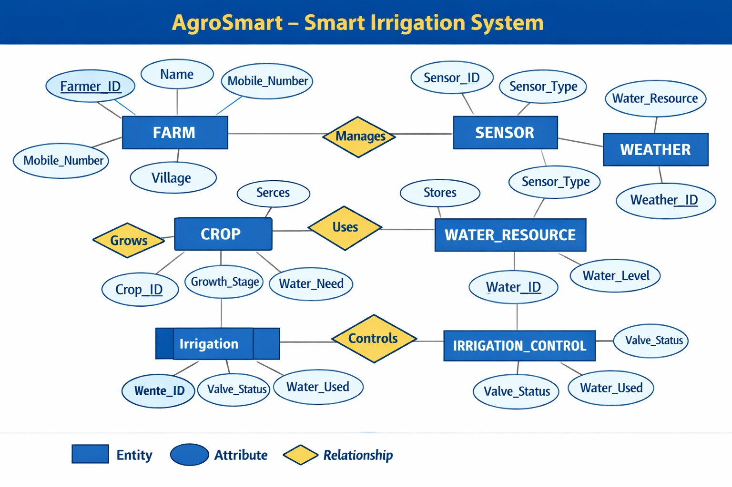
E-R DIAGRAM

Slide 9
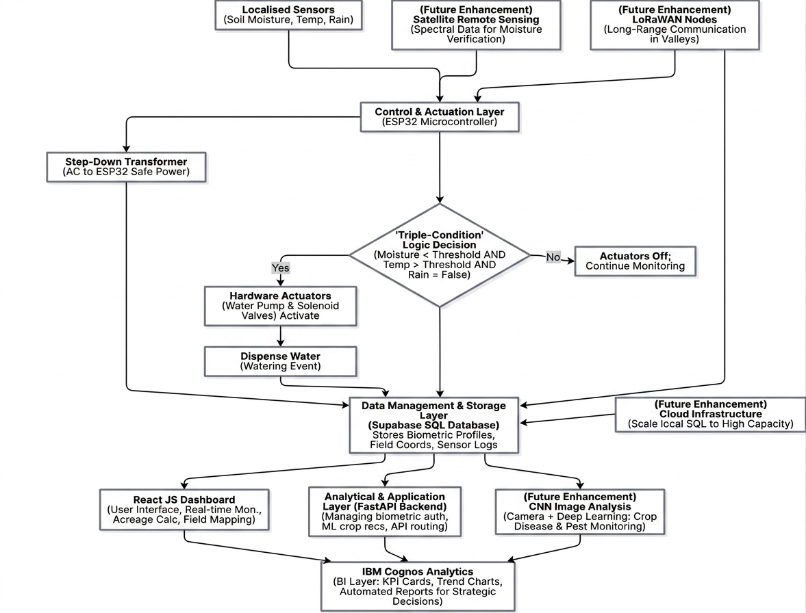
Proposed Architecture

Slide 10
Proposed Architecture- Description
The architecture follows a multi-tier flow starting at the Perception Layer, where localized sensors collect soil and weather data. This information is processed by the Control Layer, which features an ESP32 microcontroller executing a specialized "Triple-Condition" logic gate. If soil moisture is low, temperature is high, and no rain is detected, the system triggers the hardware actuators to begin irrigation. All event data, including biometric security profiles and field coordinates, are securely stored in the Supabase SQL and MongoDB database layers. Subsequently, the FastAPI backend manages the communication between the stored data and the user interface. Farmers interact with a React JS dashboard to monitor real-time field conditions and perform spatial mapping. Finally, the IBM Cognos layer transforms raw logs into strategic trend charts and automated performance reports. Future enhancements will integrate satellite sensing and CNN-based image analysis to further automate crop health monitoring

Slide 11
List of Modules
User Management Module
Map-Based Field Selection Module
Area Calculation Module
Sensor Management Module
Pipe Connection Planning Module
AI Irrigation Decision Module
IoT Data Monitoring Module
Notification & Alert Module
Dashboard & Reporting Module

Slide 12
Module Description
User Management Module: Handles user registration, login, and role-based access control for admins and farmers.
Map-Based Field Selection Module: Enables users to draw and select agricultural fields on an interactive digital map.
Area Calculation Module: Computes total field area, selected area, and percentage coverage in standard units.
Sensor Management Module: Manages IoT sensors by tracking their location, status, and real-time data.
Pipe Connection Planning Module: Designs efficient pipeline layouts and divides the field into irrigation zones.
AI Irrigation Decision Module: Analyzes sensor and environmental data to generate optimal irrigation schedules.
IoT Data Monitoring Module: Collects and transmits real-time field data from sensors to the backend system.
Notification & Alert Module: Sends alerts for critical conditions like low moisture or system failures.
Dashboard & Reporting Module: Displays field analytics, sensor data, and irrigation insights through a user-friendly interface.

Slide 13


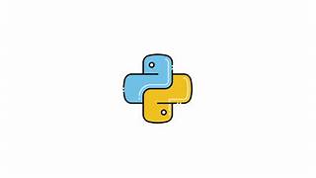
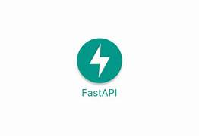

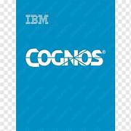
Software Specification
Frontend: REACT JS
Backend: PYTHON(FAST API)
Database: HETEROGENOUS DATABASE
Tools: IBM COGNOS,VSCODE,BLINKIT,NOTEBOOK LM
Other:IEEE PAPERS, GITHUB(RESEARCH)

Slide 14
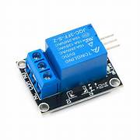

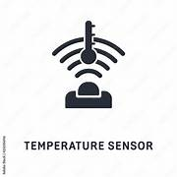
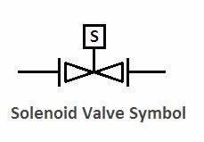
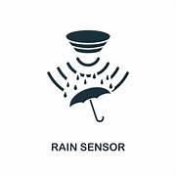
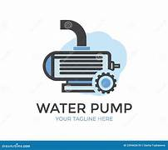
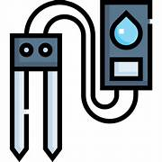
Hardware Specification
ESP32 Microcontroller Central Processing Unit: Acts as the primary controller that receives data from all sensors and executes the "Triple-Condition" irrigation logic.
Soil Moisture Sensor Hydration Monitoring: Measures the volumetric water content in the soil to determine if the field has reached a critical dryness level.
Rain Detection Sensor Precipitation Sensing: Detects the presence of rainfall on its sensing surface to prevent the system from operating during natural weather events.
Temperature Sensor (LM35/DHT11) Heat Monitoring: Tracks ambient temperature levels to help the system calculate evaporation rates and adjust irrigation frequency during heatwaves

Slide 15
Hardware Specification
Solenoid Valve Flow Control: An electronically controlled valve that acts as a gatekeeper for the water supply, opening only when signaled by the ESP32.
Water Motor Pump Mechanism: A high-torque AC motor that provides the mechanical force necessary to pump water from the source to sloped hilly terrains
Step-Down Transformer Voltage Regulation: Converts high-voltage AC mains power into a safe, low-voltage DC supply required to power the ESP32 and sensors
Relay Module Power Switching: Acts as an electromagnetic switch that allows the low-power ESP32 to safely control the high-power water motor

Slide 16

Sample Screen shot

Slide 17
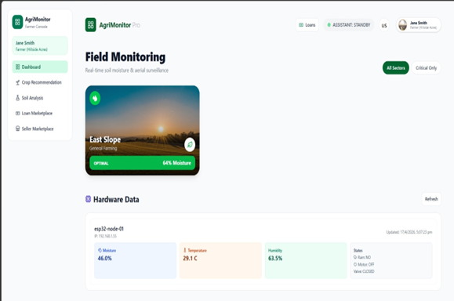
Sample Screen shot

Slide 18
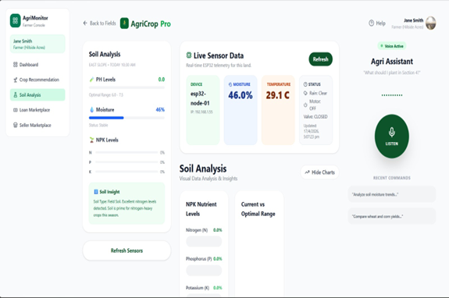
Snapshot

Slide 19
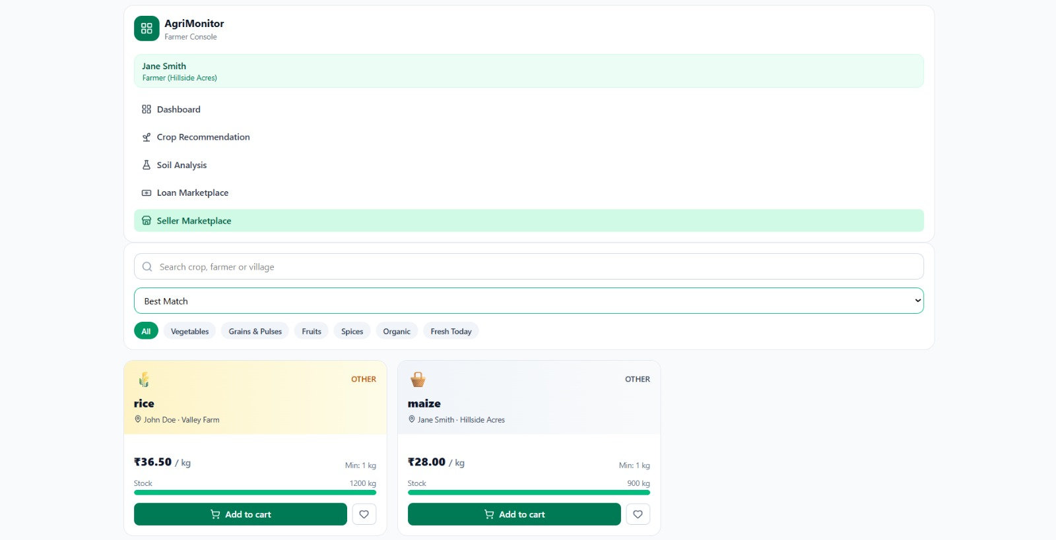
Snapshot

Slide 20
References
Reference: Maier, A., Sharp, A., & Vagapov, Y. (2017). "Comparative Analysis and Practical Implementation of the ESP32 Microcontroller Module for the Internet of Things." IEEE Conference on Internet of Technologies and Applications.
Link: https://www.researchgate.net/publication/320273388
Reference: Nayyar, A., & Puri, V. (2017). "Smart Farming: IoT Based Smart Sensors Agriculture Stick for Live Monitoring of Temperature and Humidness of Soil." International Journal of Applied Agricultural Sciences Link:https://sist.sathyabama.ac.in/sist_naac/documents/1.3.4/1822-b.e-ece-batchno- 125.pdf
Reference: Goap, A., Sharma, D., Shukla, A. K., & Rama Krishna, C. (2018). "An IoT based Smart System for Advancing Agriculture." Computers and Electronics in Agriculture.
Link: https://www.normalesup.org/~scornet/paper/test.pdf

Slide 21
Conclusion
The Smart Irrigation System provides an intelligent approach to improving agricultural efficiency in hilly regions. By integrating real-time data collection, machine learning analysis, and automated hardware, the project enhances the ability of farmers to manage water resources accurately. The system transforms traditional farming into a "Smart" unit capable of predicting soil needs and providing financial insights.It also enables farmers to plan their infrastructure through field mapping and secure their data via biometric recognition. Although the current implementation is focused on hilly regions, the system demonstrates the potential to be expanded to various terrains. Overall, the project contributes to improving agricultural sustainability, reducing water waste, and empowering farmers with modern technological tools.

Slide 22
THANK YOU
ANY QUERIES???

